Slide 1
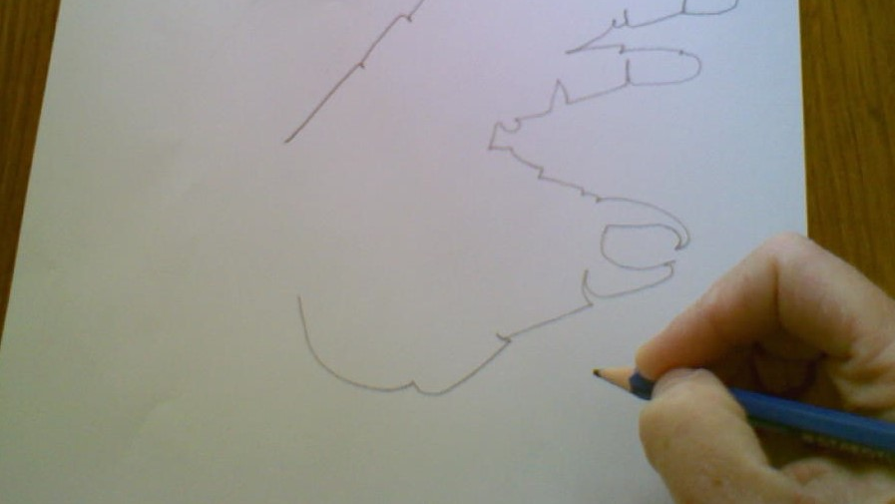
Blind Contour Drawing

Slide 2
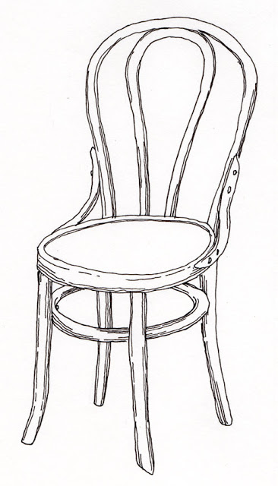
A contour drawing is a drawing that shows the edges of an object.
It can also include interior details, such as a ridge or a groove.
Contour drawings are essentially "outline" drawings, that use
no shading. "This kind of drawing is done very slowly".
(Chapman,1998 p.8)
"Making contour drawings can help you develop your ability to
view and record the world around you.
Continued practice will also help you improve your hand-eye
coordination." (Stewart & Katter, 2009)
Chair by Teri Grant. Pen, Pencil, Paper Draw
http://penpencilpaperdraw.blogspot.com/

Slide 3
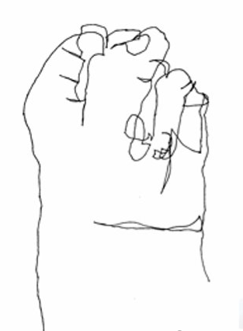
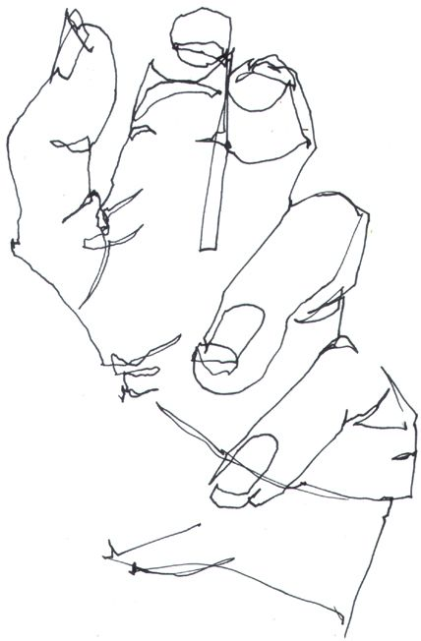
There are two types of contour drawing:
1. Blind Contour Drawings 2. Modified Contour Drawings

Slide 4
Blind contour drawings are created without looking at your paper. Therefore, it is referred to as a
“blind "drawing.
Yes, you read that right! ​
​
​
YOU ARE NOT ALLOWED TO LOOK AT YOUR PAPER while doing a ​Blind Contour Drawing. You can only look at the object that you are drawing.

Slide 5
When doing a Modified contour drawing
you follow the same process as you would when
creating a blind contour drawing, except you can
take quick glances at the object you are drawing.
This allows you to check the placement of your
pencil as you draw.

Slide 6
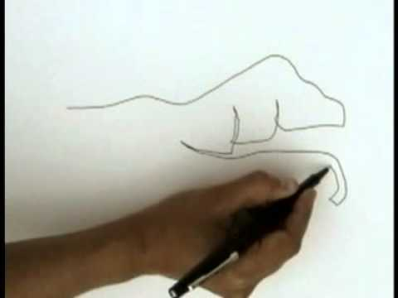
Blind Contour Tutorial Video
https://www.youtube.com/watch?v=FKHVqbM_xLU&t=6s

Slide 7
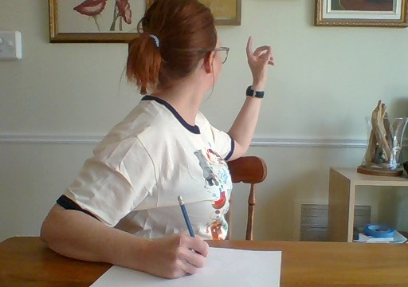
Now it is your turn to try!
Step 1:
Turn your body sideways in your chair and sit so that your dominant hand (the one you write with) is positioned over your paper.
Hold your non-dominant hand, at eye level, in the opposite direction (from your paper).
*Remember don’t look at your paper and do not lift your pencil until you are finished drawing your hand.

Slide 8
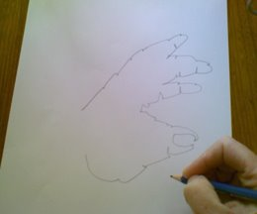
Step 2:
Look carefully at your hand. Slowly move the path of your eye over the contours of your hand, at the same time mimic the movements with your pencil on your paper.
KEEP YOUR PENCIL IN CONSTANT CONTACT
WITH YOUR PAGE.
The purpose is not to create a perfect picture,
it is to practice your hand eye coordination.
*Remember, your drawing will look
Quirky and Abstract.

Slide 9
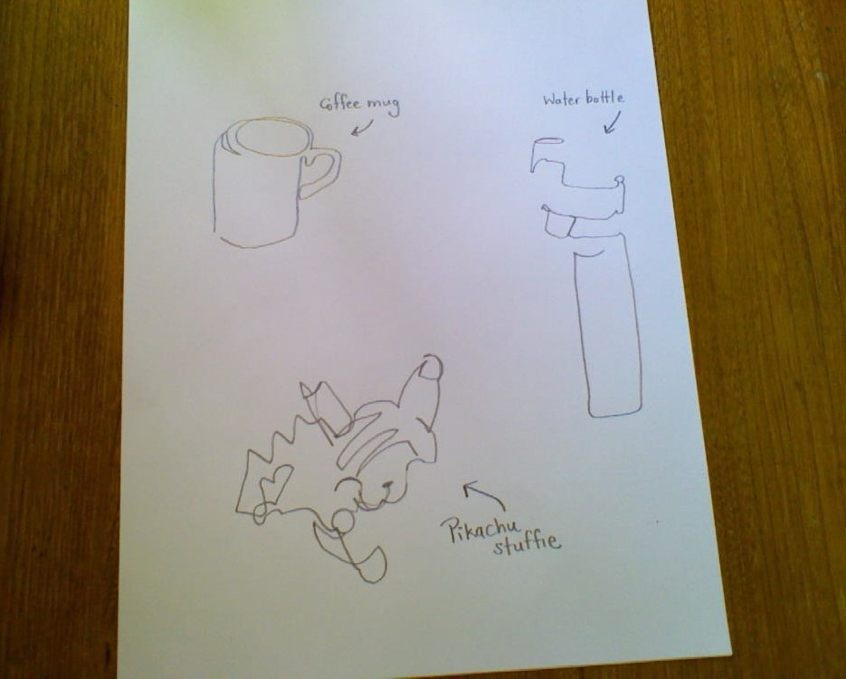
Practice creating Blind Contour drawings
of objects in your house.
​
"Making contour drawings can help
you develop your ability to view and
record the world around you.
Continued practice will also help you
improve your hand-eye coordination."
(Stewart & Katter, 2009)

Slide 10
References and Resources:
Chapman, Laura H. (1998). Adventures in Art 6. Worchester, Massachusetts: Davis Publications, Inc.
Stewart, Marilyn G. & Katter, Eldon (2009). Explorations in Art: A Personal Journey, Second Edition. Worchester Massachusetts: Davis Publications Inc.
https://dl.airtable.com/.attachments/0b39d6571ee426ebe3cc576f6415e991/1d82e6c0/WhatIsContourLine.pdf
https://www.learn-to-draw-lessons.com/hand-eye-coordination.html
https://www.pinterest.ca/pin/35747390765589440/
https://mrs-cook.weebly.com/contour-line.html
http://penpencilpaperdraw.blogspot.com/

